Slide 1
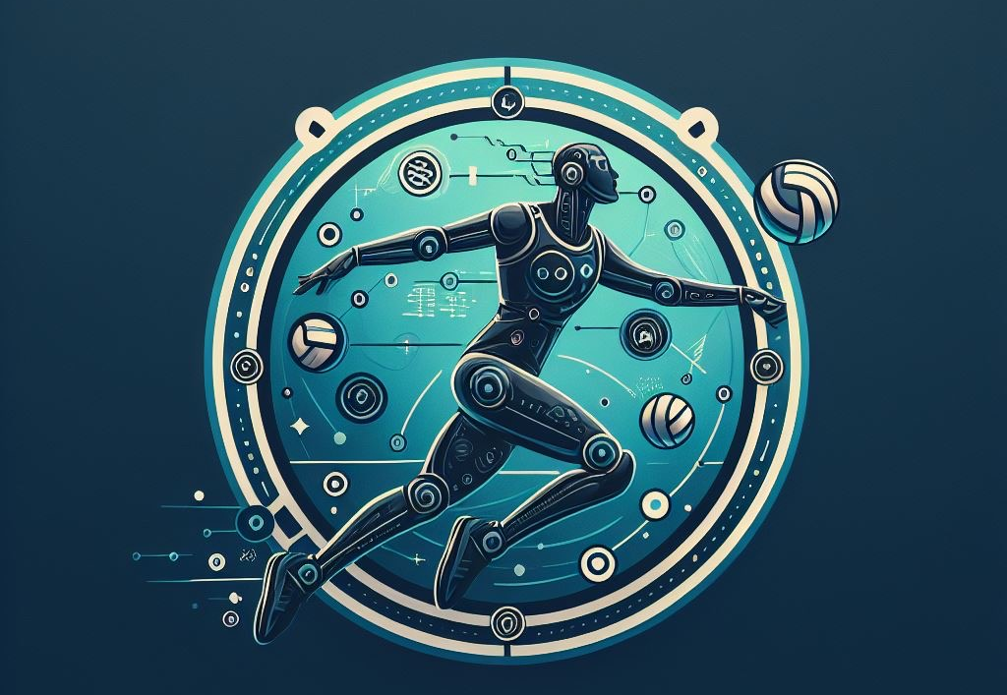

SwingServe
Notes:
Rachel

Slide 2
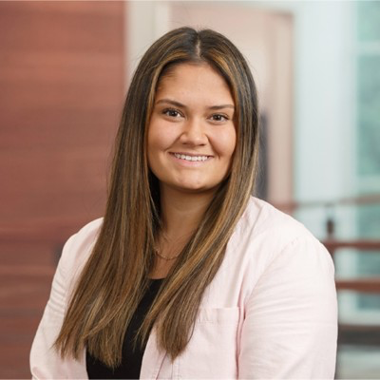

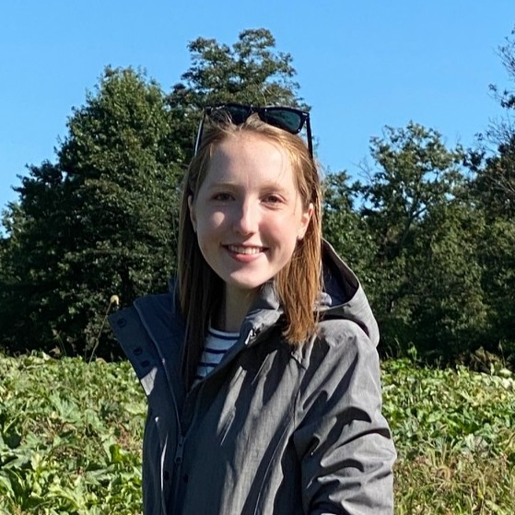
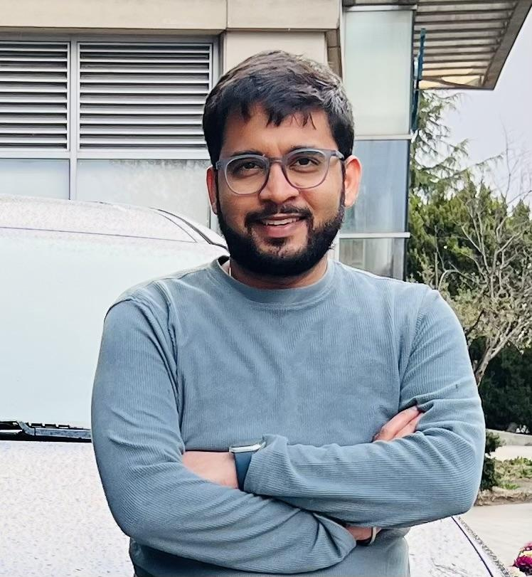
SwingServe Team
Rachel Rannikko
Anandhi Raghuraman
Hailey Warman
Sarthak Raj
Notes:
Rachel introduce team

Slide 3
Product Problem Statement
SwingServe aims to optimize volleyball training effectiveness and injury prevention through AI-driven programs that enhance player skills, team performance, and strategic understanding, while maintaining high engagement and motivation levels.
Notes:
Rachel

Slide 4
Product Vision, Goal, and Objective
Vision:
SwingServe strives to be the top AI-driven volleyball training platform, empowering players at all levels to reach their full potential within a supportive community.
Goal:
To offer a comprehensive, technologically advanced training solution that enhances individual skills, boosts team performance, and ensures player safety, all while cultivating a sense of community among volleyball enthusiasts.
Notes:
Anandhi
Vision: Become the leading AI-powered volleyball training platform.
Goal: Provide a comprehensive, advanced training solution.

Slide 5
Product Vision, Goal, and Objective
Objectives:
Enhance Skills: Leverage AI for personalized volleyball training plans.
Prevent Injuries: Utilize biomechanical analysis to minimize injury risks.
Boost Team Dynamics: Enhance teamwork and strategy with collaborative tools.
Increase Engagement: Use gamification and community features to maintain high motivation.
Expand Reach: Target various player levels globally with phased market entries.
Continual Innovation: Regularly update the platform with the latest AI technologies and user feedback.
Notes:
Anandhi

Slide 6

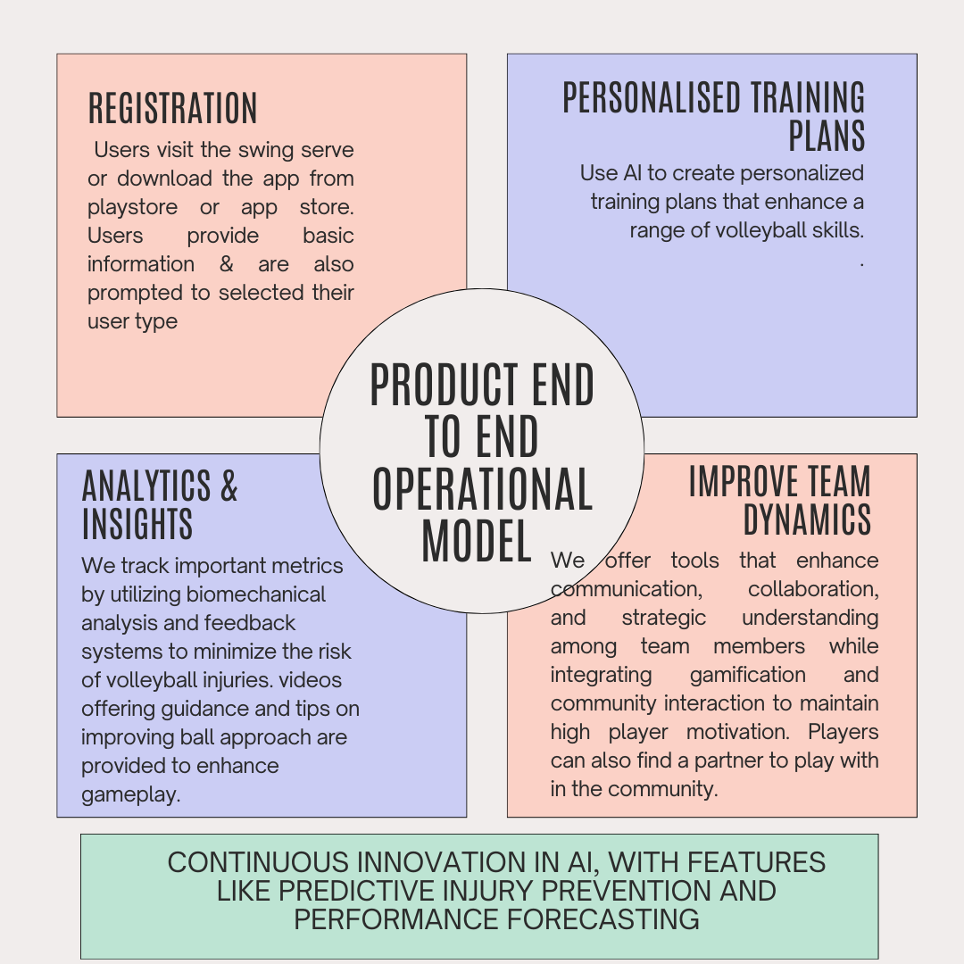
Product End-to-End Operational Model
Notes:
Anandhi

Slide 7
Market Assessment Overview
Competitor | Strengths | Weaknesses
Avais | Specialized in volleyball, advanced AI algorithms, real-time tracking, customized plans, innovative | Limited brand recognition, resource constraints, technical complexity, potential resistance to AI coaching
Hudl | Extensive video analysis tools, wide adoption among teams for game and practice analysis | May not provide as specialized AI-driven coaching for volleyball, broader focus than just volleyball
Volleyball Toolbox | User-friendly interface, practical coaching resources, social features integration | Limited AI capabilities, less emphasis on real-time feedback, smaller user base
Volleyball ACE Stats | Comprehensive data analysis, established user base, extensive training resources | Limited AI integration, outdated UI, lacks focus on advanced AI-driven techniques
Notes:
Anandhi

Slide 8
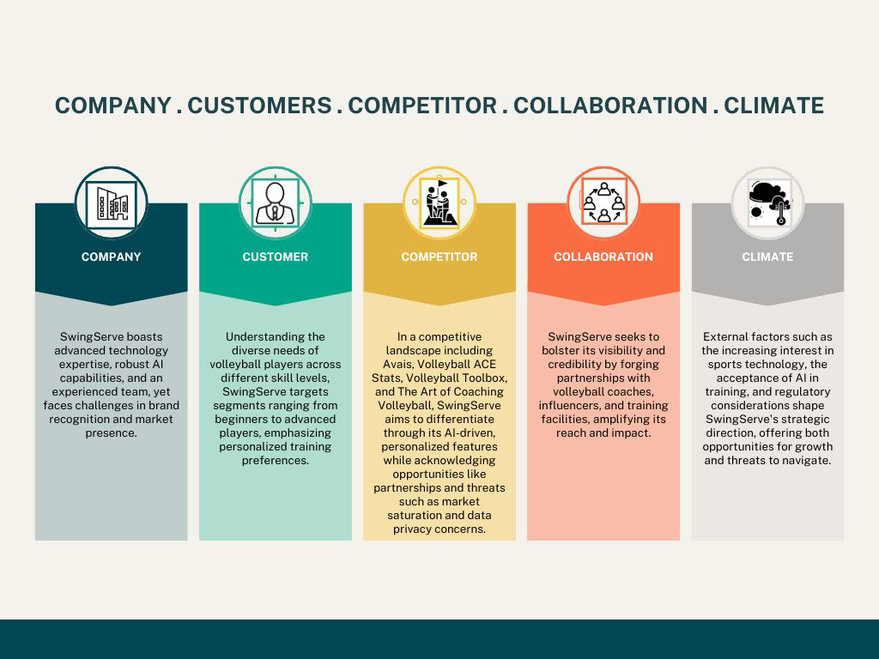
5C
Notes:
Sarthak

Slide 9

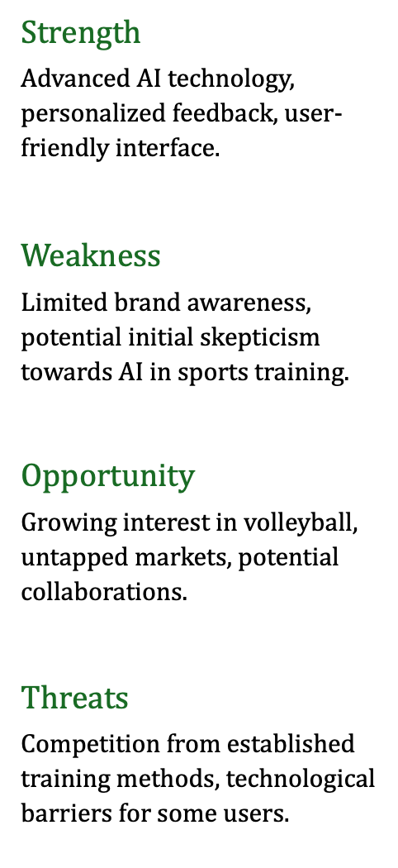

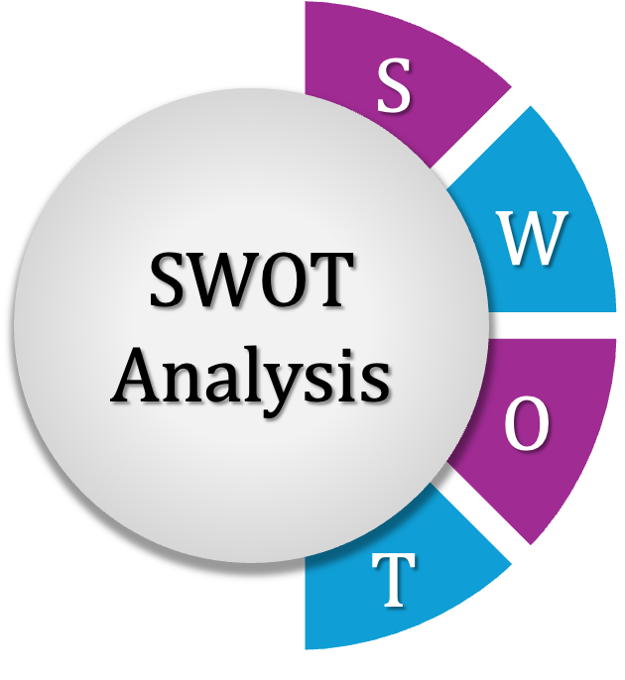
SWOT
Notes:
Sarthak

Slide 10
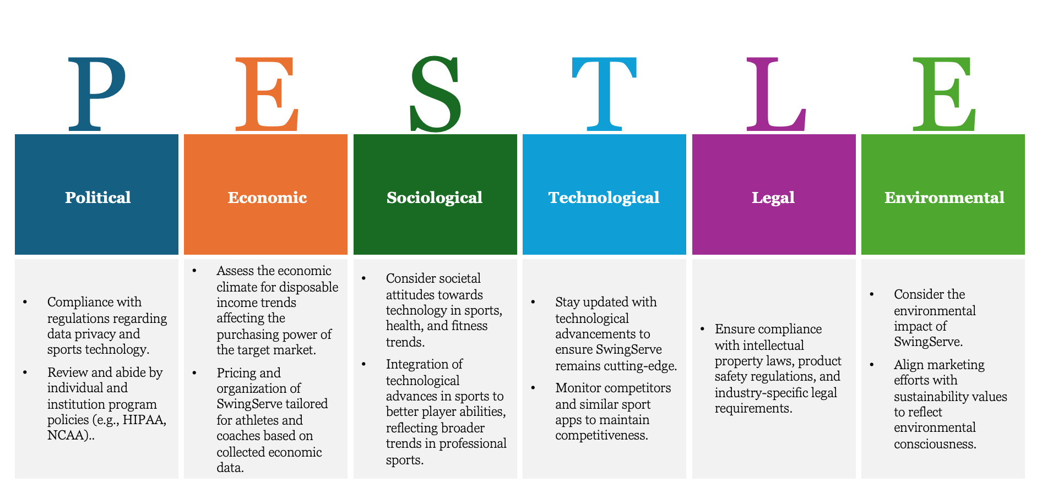
PESTLE
Notes:
Sarthak

Slide 11
Risk & Mitigation Plan
Key Risks | Impact on Timeline/Cost | Probability | Mitigation Plan
Technical Challenges | Potential delays in development and increased resource allocation | High | Drive innovation and talent acquisition in AI, ML, and sports tech, fostering continuous learning and allocating resources for R&D to stay ahead.
User Acceptance Hurdles | Slow adoption rate and reduced revenue | Medium | Boost confidence in SwingServe with free trials, thorough tutorials, and compelling user testimonials.
Data Privacy and Security Concerns | Legal implications and loss of user trust | High | Ensure compliance with HIPAA and NCAA regulations through encryption protocols, transparent privacy policies, and user-friendly opt-in/opt-out mechanisms.
Market Saturation Risks | Reduced market share and revenue | Medium | Drive innovation, expand markets, and differentiate SwingServe with AI-driven analysis, personalized coaching, and community engagement.
Legal and Regulatory Compliance | Legal disputes and penalties | Medium | Ensure legal compliance through thorough research, expert consultation, and regular policy updates, fostering a culture of compliance within the organization.
Brand Recognition Challenges | Limited market visibility and reduced brand equity | Medium | Leverage strategic marketing initiatives and partnerships within the volleyball community to enhance brand visibility, engage target audiences, and drive growth.
Notes:
Sarthak

Slide 12
Product Life Cycle
Maturity
Sales
Growth
Decline
Initiation
Time
Notes:
Rachel

Slide 13
Product Roadmap
DEVELOPMENT
PROMOTION
LAUNCH
4 MONTHS
3 MONTHS
2 MONTHS
2 WEEKS
3 WEEKS
2 WEEKS
->
Customer Development
Market Strategy
Beta Test
Announce Launch
Social Media Campaign
Selling
Promotion, Media Coverage & Grand Launch Event
- Survey Potential Users
- Validate Interfaces
- Modify Product based on Feedback
- Position and Emphasize Volleyball Improvement via AI analysis
- Communicate Product
- Initiate Beta Testers and Environments
- Bug Testing
- Testing: Iterative & Continuous Analysis
- Pre-Launch Preparation & Outreach
- Partner Collaborations and Teaser Campaign
- Teaser Campaign
- Influencer Collaboration
- Launch and Promotion
- Targeted Advertisements
- Live Events
- Limited-Time Deals
- Analyze Metrics
- Final Validation of Test
- Press Release
Notes:
Rachel

Slide 14
Technology Roadmap
Competitive/Professional Athletes & Parents/Coaches
YEAR:2026
Expansion: Roll out in additional cities with strong volleyball communities, such as Boston and New York
App Model: Introduce tiered subscriptions for different levels of engagement and access to advanced features
Higher Education Institutions
YEAR:2029
Expansion: Test international markets, starting with a pilot in Canada and Europe, focusing on countries with high volleyball participation.
App Model: Subscription model refined based on user feedback and international market demands, with localized content and features.
SwingServe
SwingServe
4.0
2.0
High School Players
YEAR:2025
Focused launch in Los Angeles: leverage a market of volleyball enthusiasts & tech-savvy users
App Model: Free with limited features; offer premium features through a subscription model to gather feedback and adjust product offerings
SwingServe
Solidify Presence for Advanced Players
YEAR:2027
Expansion: Launch nationwide, focusing on volleyball clubs, schools, and associations for partnerships
App Model: Freemium model with in-app purchases for personalized coaching sessions and wearable integration features
1.0
Global Volleyball Community
YEAR:2031
Expansion: Full international launch, focusing on establishing SwingServe as the leading volleyball training platform globally.
App Model: Implement dynamic pricing based on the region and competitive positioning. Explore partnerships for bundled offers.
SwingServe
3.0
SwingServe
5.0
Notes:
Rachel

Slide 15
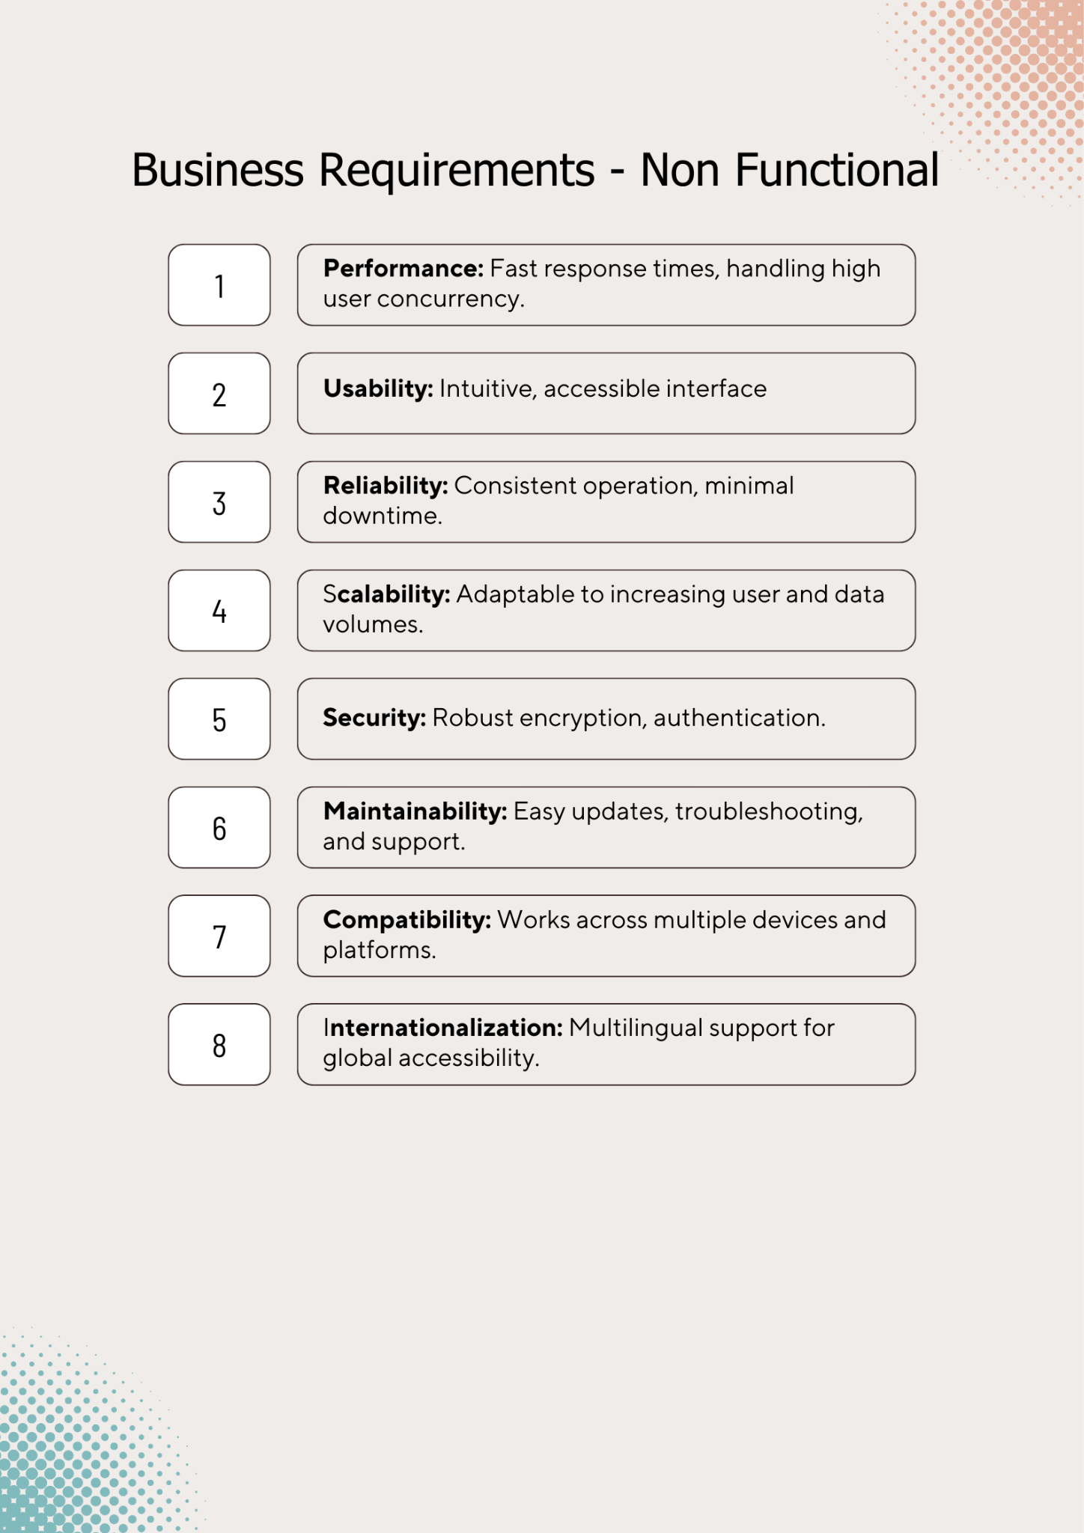
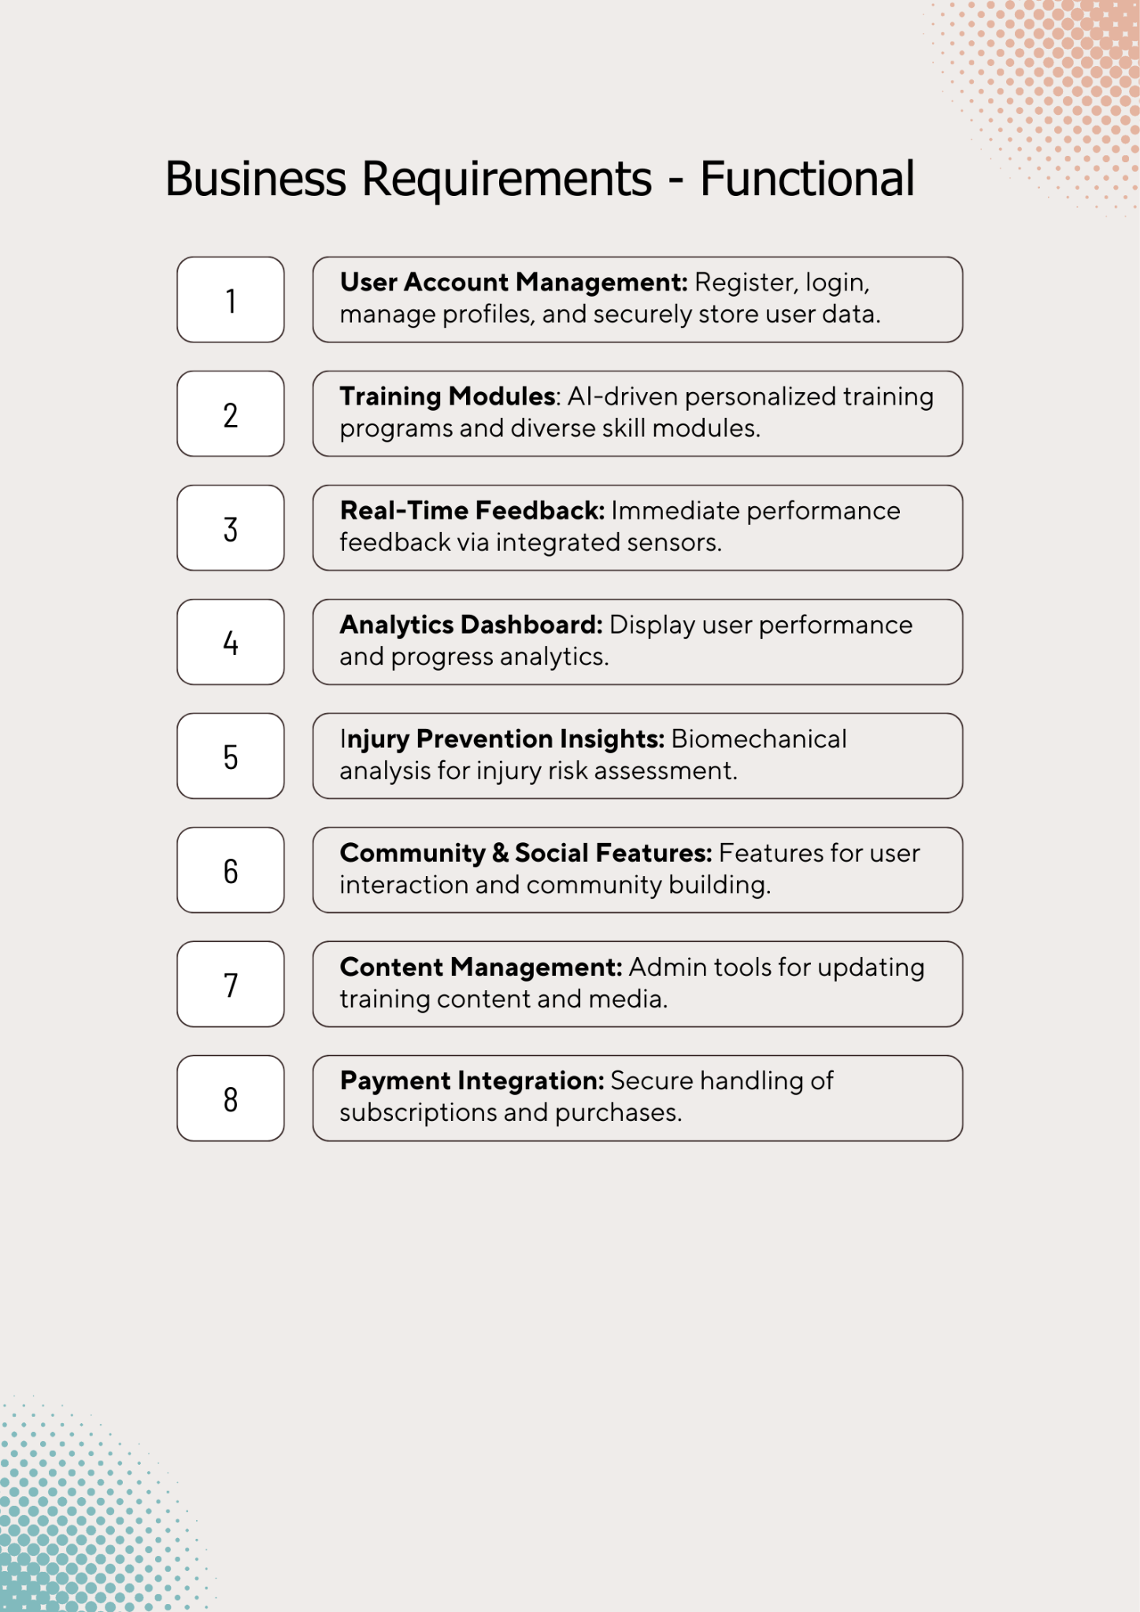
Business Requirements

Slide 16
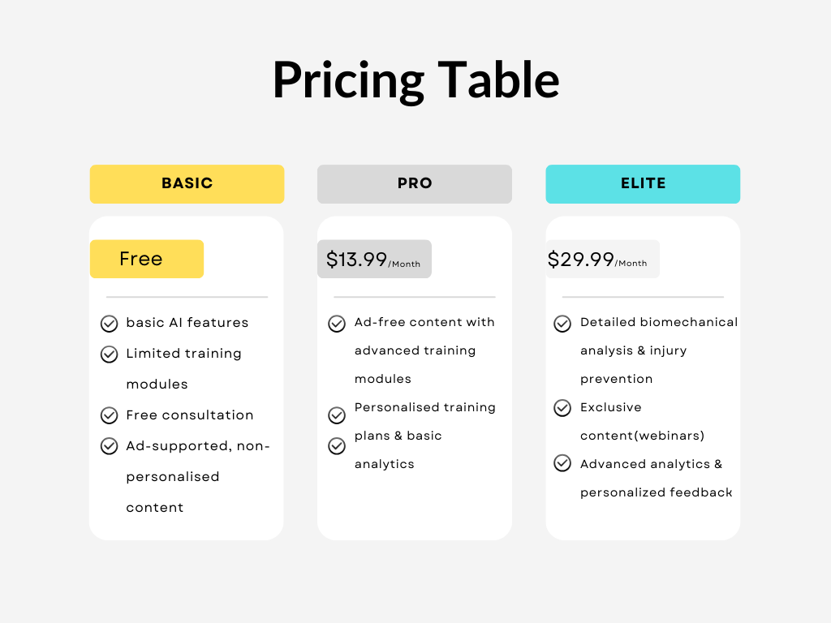
Cost Breakdown - Pricing

Slide 17
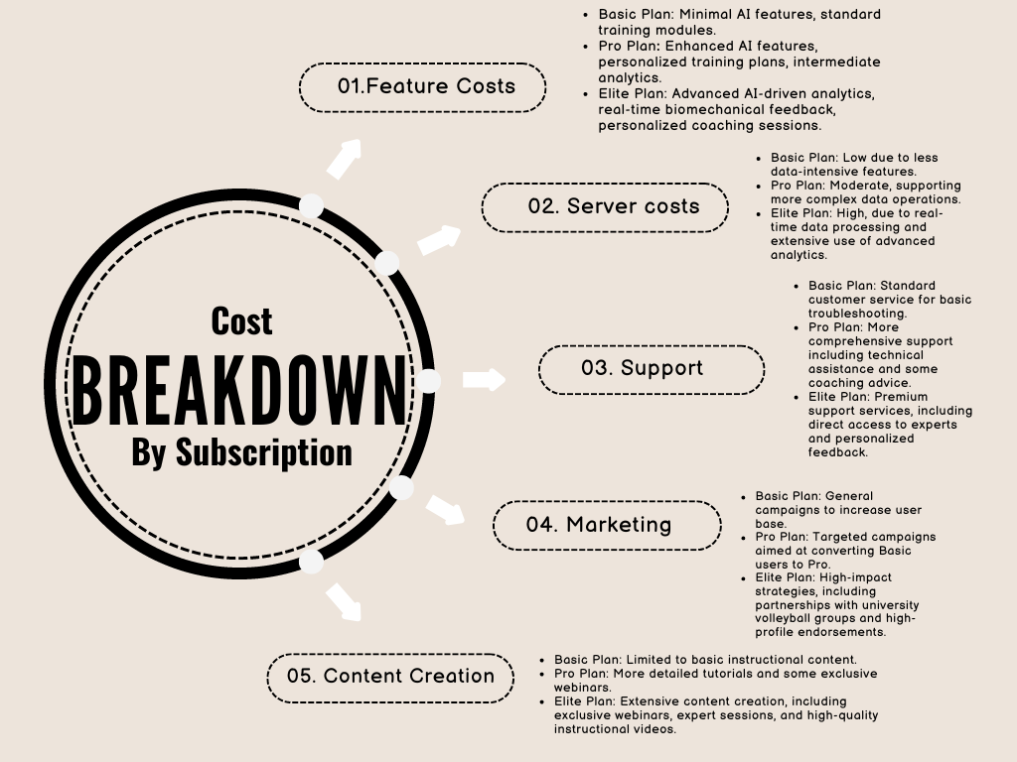
Cost Breakdown by Subscription Plan

Slide 18
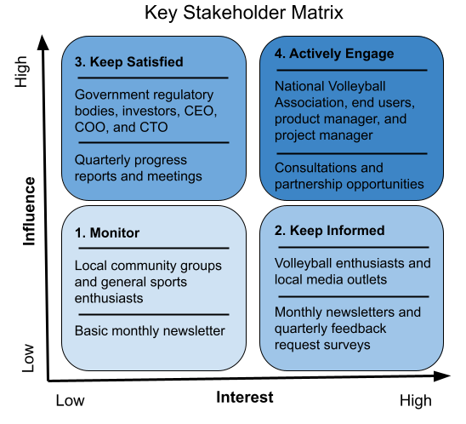
Key Stakeholder Matrix
Notes:
Hailey

Slide 19
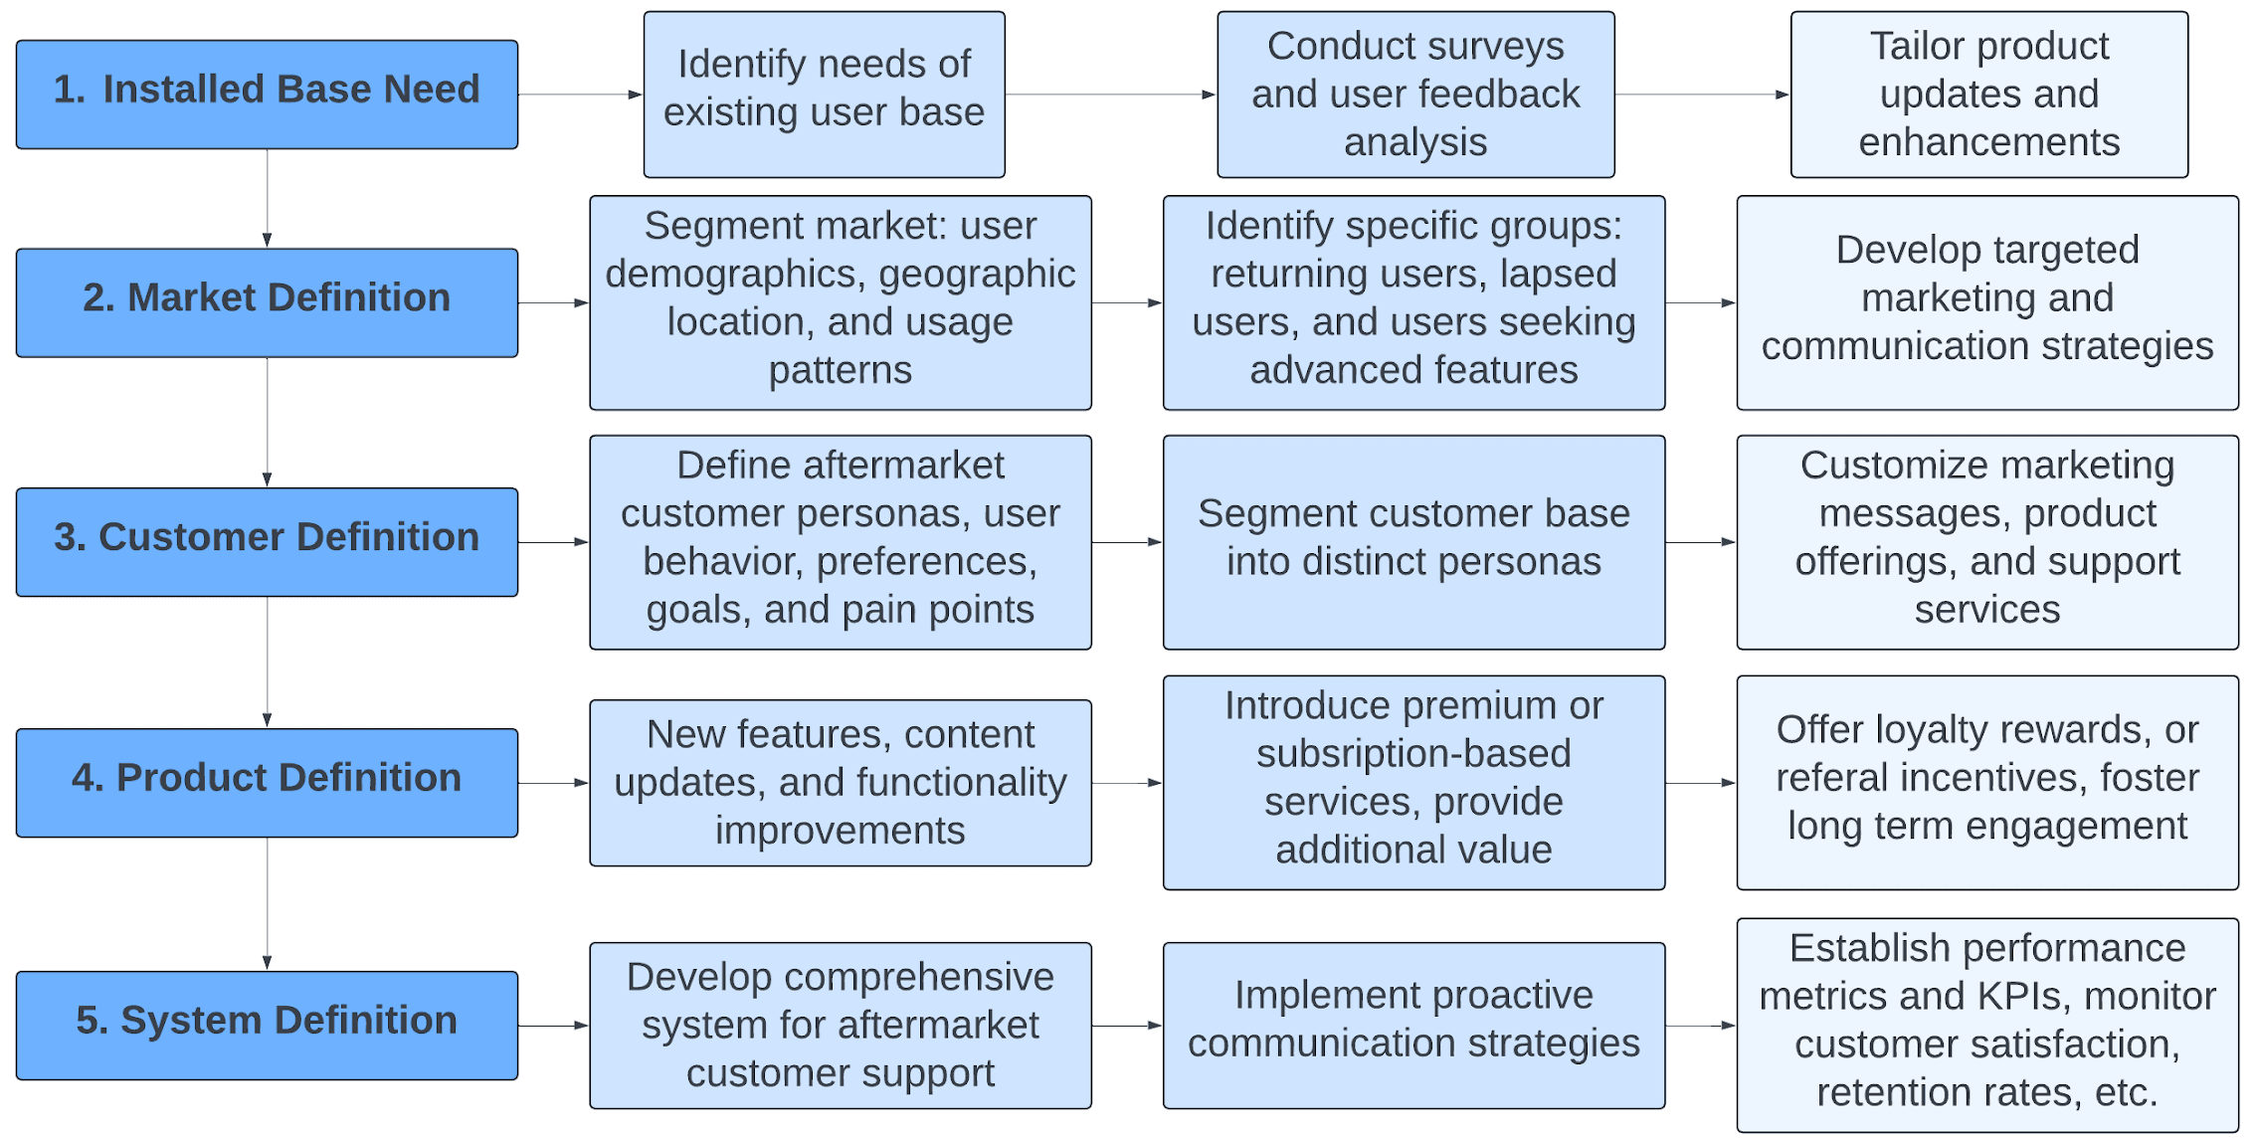
After Market Strategy
Notes:
Hailey

Slide 20
Thank you,
Questions?
Notes:
Hailey

Slide 21
Career Goals
Development of Mobile App:
11 months to develop and launch the app
10,000 app downloads within 2025
Establish AI Technology:
70 % accuracy rate of AI-driven features (e.g., percentage of successful injury predictions)
20% improvement in player performance attributed to AI recommendations (e.g., percentage increase in serving accuracy) within the first month of use
Acquire Target Audience and Customer Personas:
10,000 active users segmented by demographics in 2025
60 % conversion rate from free trial to paid subscription
Connections with Volleyball Clubs, Schools, and Rec Leagues:
100 secure partnerships established in 2025
90 % participation rate in partnered events or programs
Community Connections are Established:
3,000 followers maintained across social media platforms
500+ people in attendance at all community events or workshops hosted by SwingServe
Expansion Across Field:
Two new regions where SwingServe is available after the first year
60% growth rate in user base in new regions
Maintain and Address Product Based on Customer Feedback:
5,000 feedback submissions
24 hour response time to address customer issues or suggestions
75% Customer satisfaction score (CSAT) based on feedback

